Slide 1
This is an OPL for creating wordles and topics using python script
Sayantan Das

Slide 2
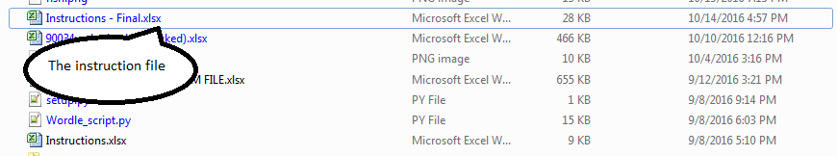

Put the Instruction.xlsx file and the python script in the same folder
Open the instruction file and fill in the details for your text analysis in the data tab. Use instructions from the instruction tab to fill in the data tab. Use the example tab to see an example of how to fill the instructions file.

Slide 3
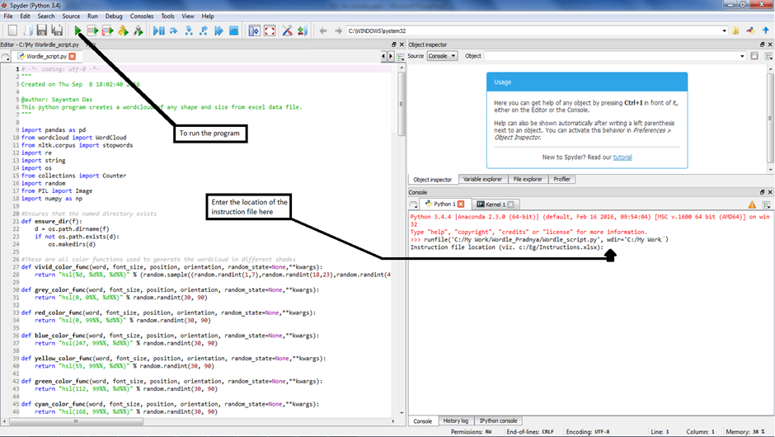
Open the python program and run it: provide user inputs when prompted

